Slide 1
Lesson 12 OOP
Neat python tricks, isinstance, enums

Slide 2


2 new great python tricks - for inline documentation and clarity
To specify the return type of a function (meaning, the datatype the function is expected to return), use an arrow -> (Notice that the coln that goes at the end of the parameter list (function signature) comes AFTER the return type)
To specify the datatype of a parameter, use a colon :
Although not required, this new feature (of python 3.6) is something I would strongly encourage you to use:
It makes your code readable and understandable to someone else using it (and to yourself when you come back to it)
It will help you follow along your own code when you are coding and when you look at it. If you still feel not so comfortable coding, this is definitely a good practice to implement.
== BEST PRACTICE!
A colon can also be used to specify the datatype of a variable

Slide 3
Guess what? It works for classes too!
Specifying the datatype of a parameter as a specific class type. The parameter called classroom1 is expected to be of type Classroom. (In other words, it is expected to be an instance of the Classroom class)
Specifying the return type of a function as a class:
Use this as a guide for the various datatypes (like lists):https://mypy.readthedocs.io/en/stable/cheat_sheet_py3.html

Slide 4
isinstance()
about:blank#blocked
about:blank#blocked
If we have an object and we want to check the which class it is an instance of, we use isinstance().
It accepts 2 arguments: the instance you want to check and the class name you want to check against
It returns a boolean
You can also check isinstance against a Base class and it will return True.

Slide 5

type()
Similarly, you can find out the class of an object by calling type()
type() accepts one argument - the object that you want to check
It returns the class to which the instance belongs. For example, below, result would be Rabbit
You can also check type() like this: Which is very similar to isinstance
Checking type() against a base class will not work like isinstance() does

Slide 6
enum
List of related values that are constant and unique
Advantage - strings can be mistyped, enums become built it so they can’t be mistyped
For example, instead of checking: You can check:
https://www.pythontutorial.net/python-oop/python-enumeration/

Slide 7
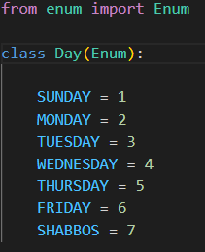
Enum - syntax
The way to define an enum is by defining a class that inherits from the built-in class called Enum. (don’t forget to import enum)
Naming Convention: same as class (CamelCase)
The members of the enum (the list) should all be capitalized (by convention) because they are constants
Notice that the enum has a name and a value. The names are Sunday, Monday, etc and the values are 1, 2, 3

Slide 8

Enum - syntax
You can access the name and value of any enum instance.
If you have a string and you want to access the Enum instance that maps to that string, use brackets. Case sensitive!

Slide 9
Use of Enums
You can use an enum as a variable or an attribute of a class.
For example, you can define a class planner with an attribute current_day which stores the enum value for the Day of the week.
Lets do it together:
https://deepnote.com/workspace/Bassie%20Witkin-511f62db-d864-49b6-b1b3-17e7caebe742/project/Course-2022-85b2d840-de20-4fd8-8c72-2d6b125bac85/notebook/Notebook%201-96ff5486577e4ada9f4a9b05491164b9

Slide 10
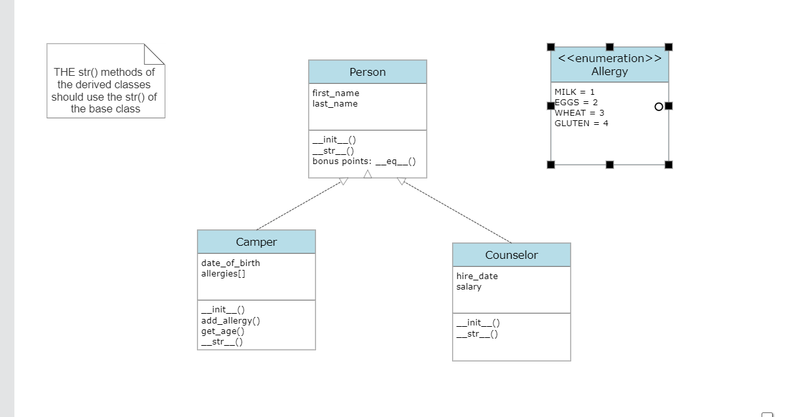

Slide 11
Instructions: These instructions are ONLY clarifying the UML diagram on the previous slide. You should NOT be using these instructions alone, but as an explanation for the diagram
Define a class Person, Camper, Counselor. Camper and Counselor inherit from Person.
Define an enum for allergy
The instance attribute for allergies[] in a camper should be a list that stores Allergy enum values. When you initialize it in the constructor, it should start off as an empty list. The function add_allergy should accept a string, convert that to an enum, and then add it to the instance attribute of the list of allergies.
The get_age method for Camper should use DateTime.now minus date of birth to calculate and return the age of the camper.
You do not need to write a main yet.

